Slide 1


HUNGRY CHEF
Dr. APJ ABDUL KALAM SCHOOL OF ENGINEERING
Discover a world of flavors with the easy-to-use recipes
Team Members:
23BTCE125: Jashmi K S [jashmi29]
23BTCE128: Keerthana V [Keerthi0810]
23BTCE139: Monika H R [ MonikaH-R]
23BTCE166: Shirley Irene [Irene1407]
23BTCE173: Suravi Prakash [suravi29]

Slide 2

Hungry Chef
The Hungry Chef website is a food lover's paradise! We're passionate about bringing you the best recipes, cooking techniques, and culinary inspiration. - Whether you're a seasoned home cook or just starting your culinary journey, we've got something for everyone.
Uncover a treasure trove of delicious recipes from around the globe. From traditional favorites to innovative creations, these websites offer a plethora of culinary inspiration for every home cook. Let your taste buds travel without leaving your kitchen!

Slide 3

A World on a Plate: Our website offers recipes from various cuisines, from the spicy curries of India to the hearty pastas of Italy, and everything in between. You can find dishes for any occasion, from quick weekday meals to impressive dinner parties.
Search Made Easy: The website has a user-friendly search function where you choose what you want to cook based on your cravings.
More Than Just Ingredients: Each recipe goes beyond just listing ingredients. They often include step-by-step instructions, beautiful pictures of the finished dish, and helpful tips to ensure your culinary creation to be a success.

Slide 4
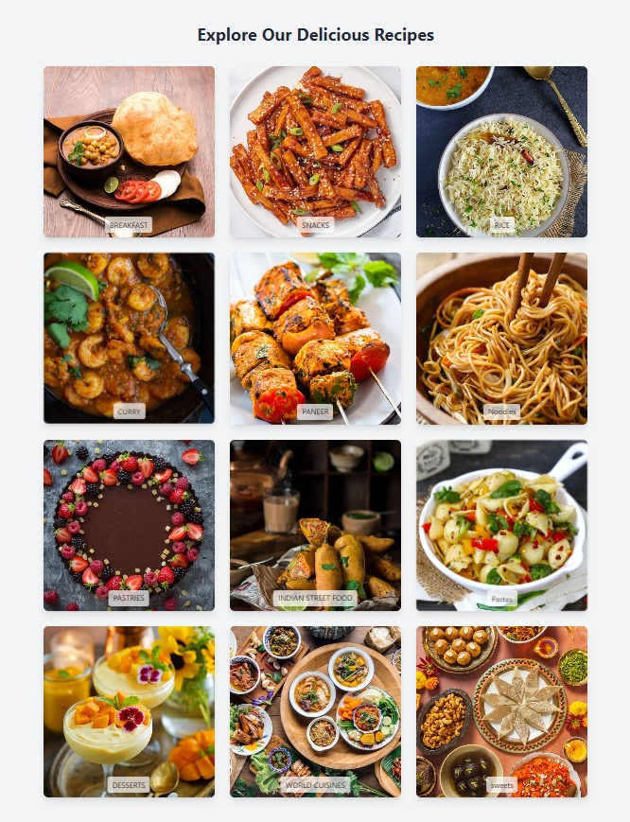
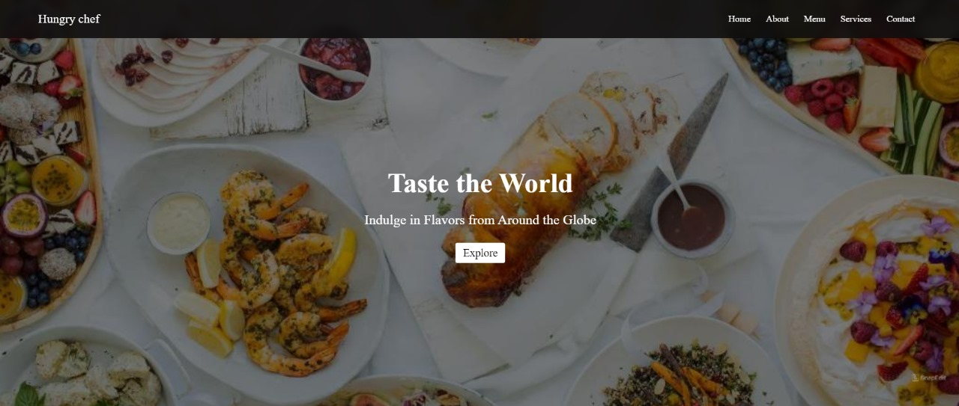
HOME PAGE
Notes:
Recipes: out recipe collectionExplore a wide variety of mouthwatering recipes—from classic comfort foods to exotic dishes. Our collection covers breakfast, entrees, desserts, and drinks.

Slide 5
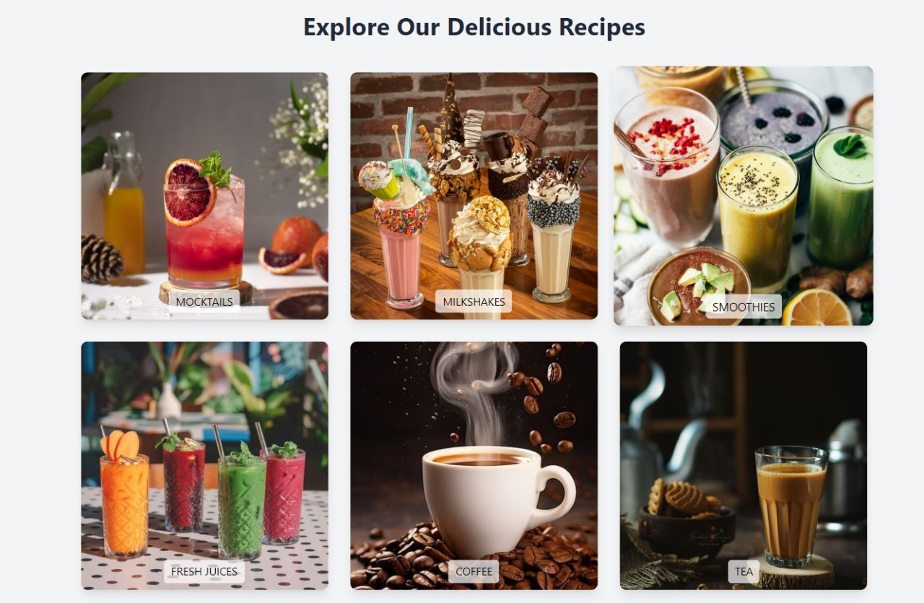


Slide 6

About Us
Notes:
Our mission is to empower

Slide 7
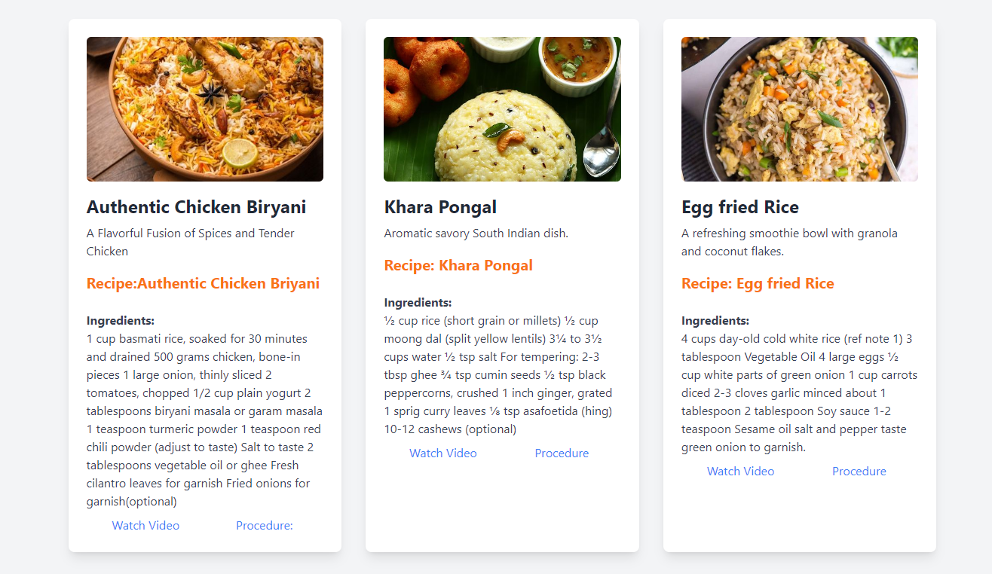
Notes:
Redirects to youtube channel

Slide 8
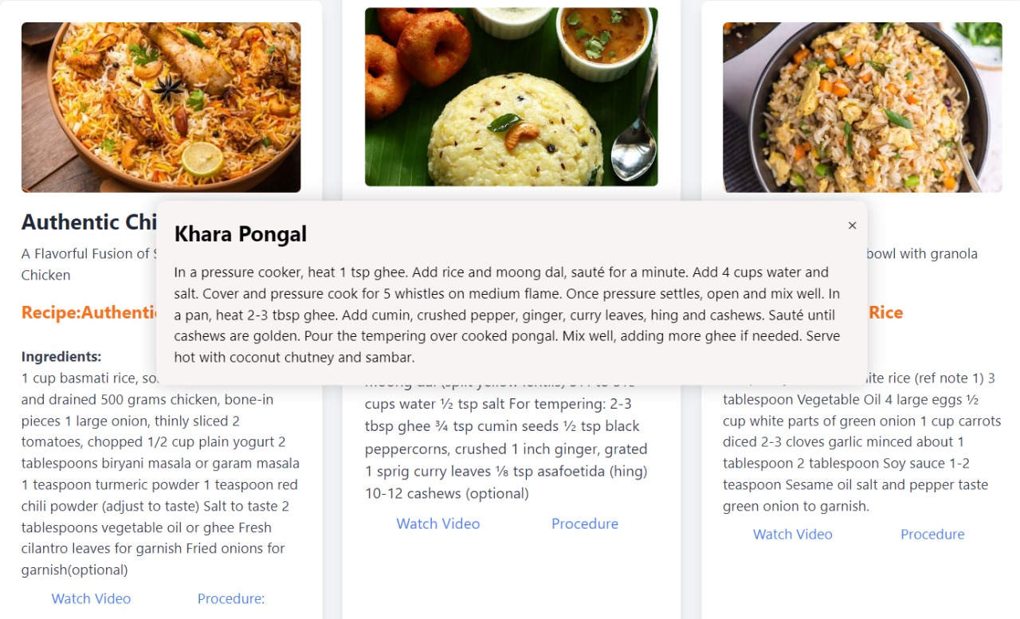
Notes:
Pop up template

Slide 9
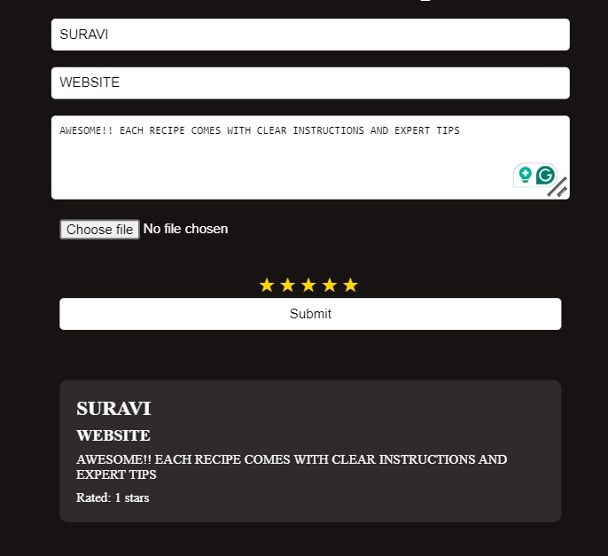
CONTACT US
Notes:
Contact: Reach out to us for inquiries, review and feedback, or just to say hello!

Slide 10
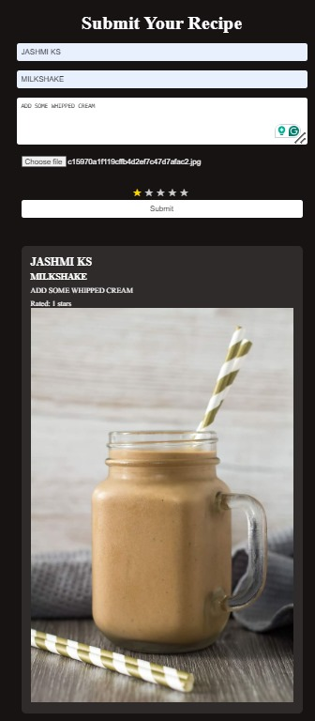
Special Features
Interactive Recipe Upload: Users can upload their own recipes, photos, and cooking experiences. Share your culinary creations with the Hungry Chef community!
Ratings and Reviews: Rate and review recipes you've tried. Let others know which dishes are a hit!
Responsive Design: Our website is optimized for all devices—desktop, tablet, and mobile. Enjoy seamless browsing and easy navigation.

Slide 11

FUTURE ENHANCEMENTS
Integrate social media sharing to encourage users to share their creations and Connect with fellow food enthusiasts.
Integrating AI to the count the calorie of food we will be consuming
Utilize AI to analyze user preferences based on past searches, dietary restrictions, and saved recipes.
Recommend recipes based on user's pantry staples, suggesting meals they can create with existing ingredients.
Gamify the recipe creation process with points and badges for completing recipes, trying new cuisines, or uploading photos of their creations.

Slide 12
Thank you!!

